Slide 1
Warehouse Drone Collision Avoidance
Interim presentation by Tristan van Vegchel
October 30, 2019
Notes:
Introduce yourself
State company and role (graduation intern)
State project

Slide 2
Table of Contents
Introduction
Context
Assignment
Simulation
Reason for Creation
Current Status
Git Pages
Research
Approaches
Curriculum Learning
Imitation Learning
Conclusion
Summary
Prospect
Reflection

Slide 3


Context
Over 235.000 m² of warehouse capacity
Inventory control & management
Employees solely dedicated to scanning pallets
Notes:
Founded in 1985, currently boasts 700 employees.
focuses on overseas logistics, forwarding and distribution, and supply chain solutions.
Warehousing is the base that links all core activities
Partially replace employees with drones

Slide 4
Assignment
Goals:
Collision Avoidance
Simulation
Extension:
Indoor self-flying
Barcode recognition
Notes:
Goals are minimal products.
Extensions are optional.

Slide 5
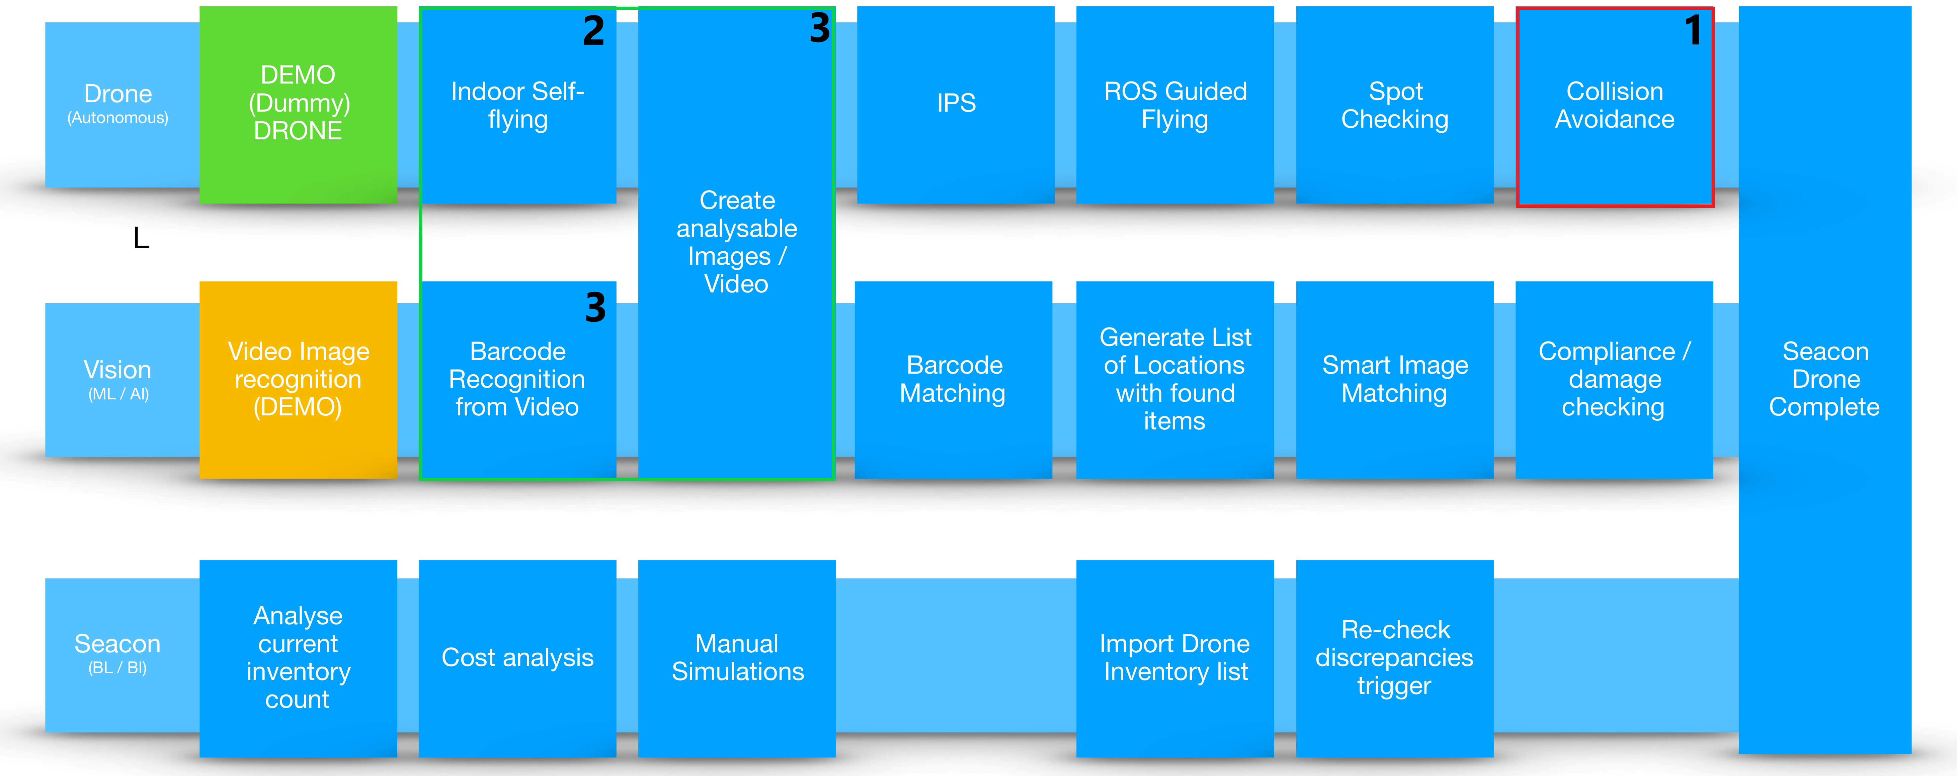
Assignment Cont’d
Notes:
My project is a subset of a larger project. Red part (1) is mandatory, green (2+) is optional

Slide 6
Table of Contents
Introduction
Context
Assignment
Simulation
Reason for Creation
Current Status
Git Pages
Research
Approaches
Curriculum Learning
Imitation Learning
Conclusion
Summary
Prospect
Reflection

Slide 7

Reason for Creation
Risk of damage
Battery limitations
Sped-up simulations
Notes:
Risk Matrix.
Red outline values did change from the report
Second-biggest risk

Slide 8
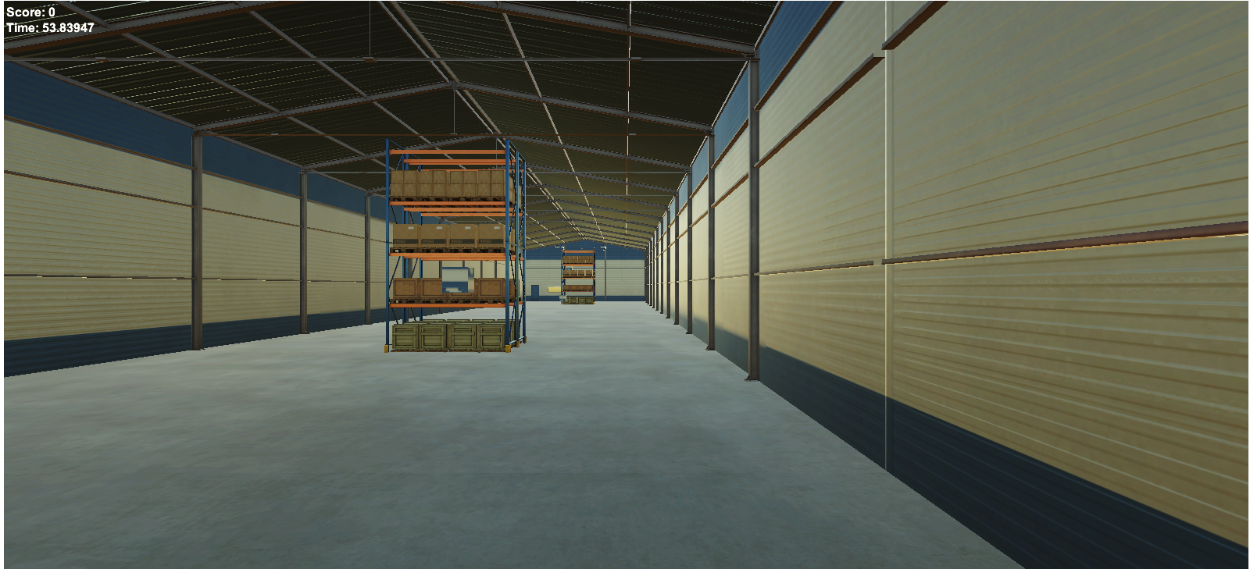
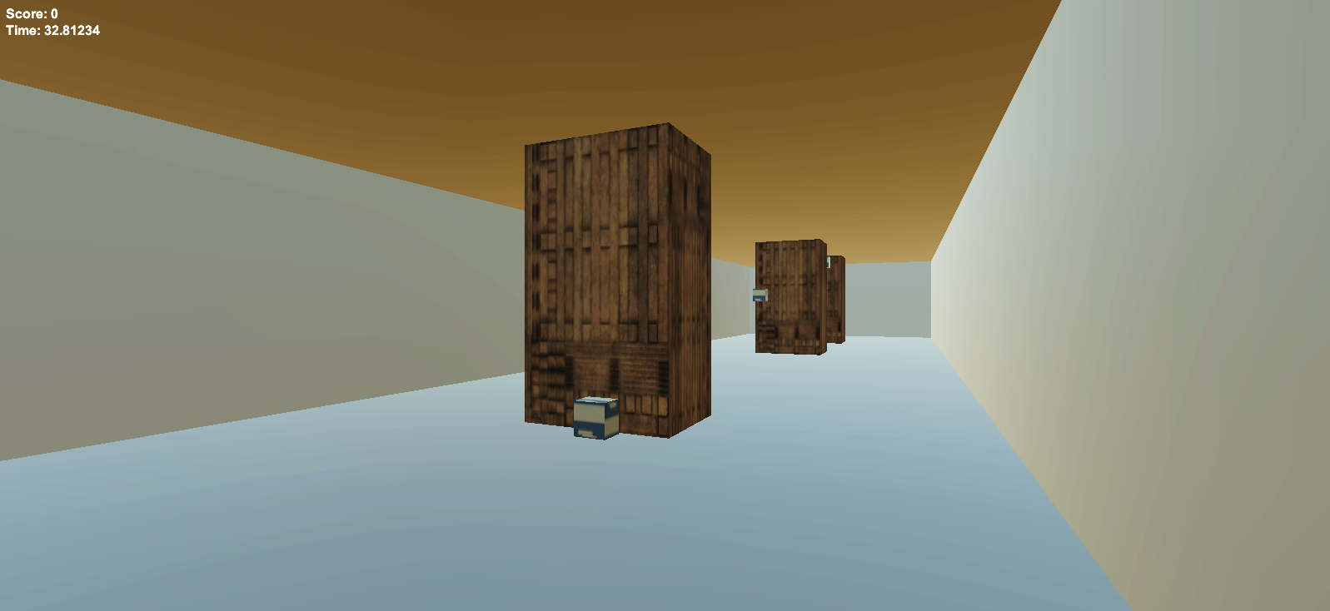
Current Status
Notes:
This is the latest version mentioned in the report

Slide 9
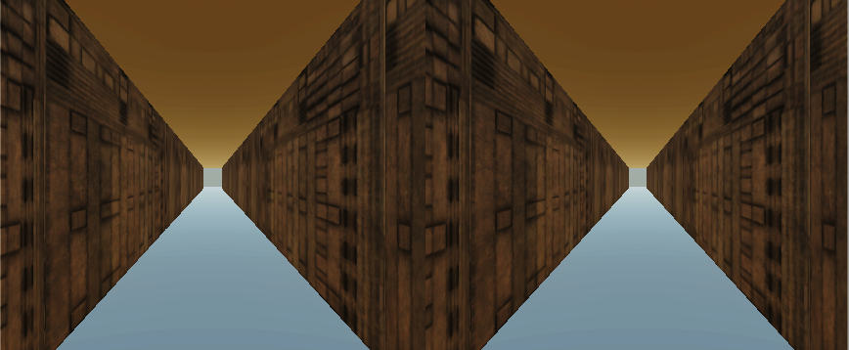
Current Status Cont’d
Player 1
Player 2
Notes:
Current latest version
Why it is 2 player is explained with imitation learning

Slide 10
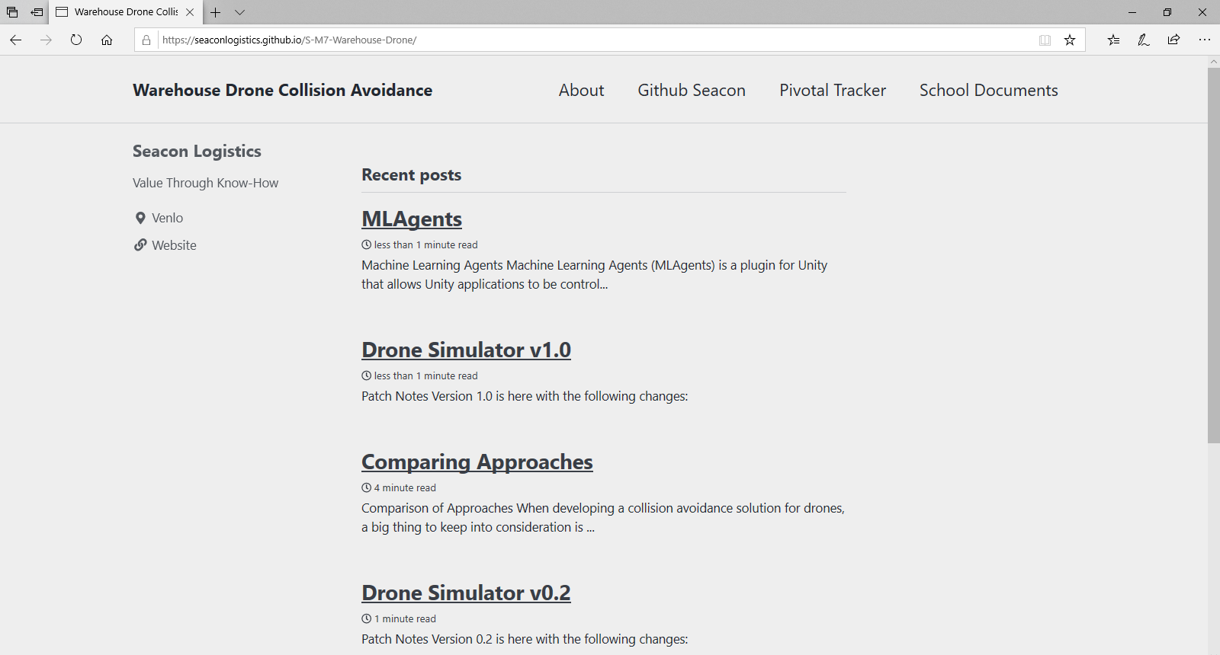
Git Pages

Slide 11
Table of Contents
Introduction
Context
Assignment
Simulation
Reason for Creation
Current Status
Git Pages
Research
Approaches
Curriculum Learning
Imitation Learning
Conclusion
Summary
Prospect
Reflection

Slide 12

Approaches
Subsumption Architecture (Non-A.I.)
Single-Shot Detector (Partial A.I.)
Curriculum Learning (A.I.)
Imitation Learning (A.I.)
Notes:
Subsumption is researched for comparison and as fallback
SSD needs algorithm or sensor for distance

Slide 13
Curriculum Learning
Strain of Reinforcement Learning
Based on curriculum concept
Optimal performance
MLAgents
Empty room /w single target
Locate target
Fly towards target
Obtain target
Room with racks and single target
Locate target
Fly towards target
Avoid collision
Obtain target
Room with racks and multiple targets
Locate targets
Determine shortest path
Fly path
Avoid Collision
Obtain targets
Problems:
The “Why” behind decisions
Transfer learning
Notes:
Does not understand decision-making for the long run

Slide 14
Imitation Learning
Human
A.I.
Supervised
Real time possibilities
Intrinsic rewards
Human-like performance
MLAgents
Problems:
Humans make mistakes
Incomplete data
Notes:
Best of both worlds: unsupervised + supervised
Imitation learning is close to curriculum, but might not have the ‘why’ problem.
Cannot train with realistic sensors

Slide 15
Table of Contents
Introduction
Background Information
Assignment Description
Simulation
Reason for Creation
Current Status
Git Pages
Research
Approaches
Curriculum Learning
Imitation Learning
Conclusion
Summary
Prospect
Reflection

Slide 16



Summary
Collision avoidance
Simulation
2 out of 4 approaches
Notes:
No collision avoidance yet
Simulation operational
2 out of 4 approaches researched without success

Slide 17
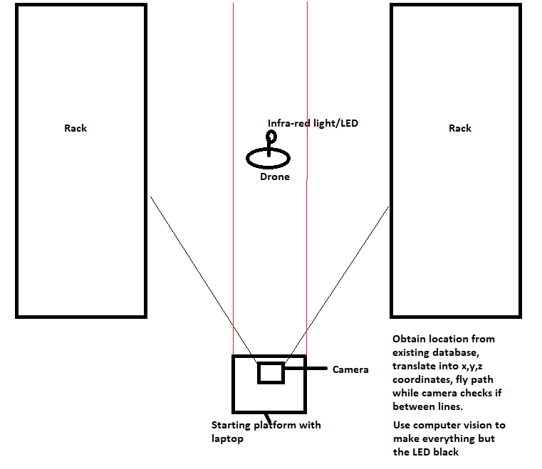
Prospect
Point of no return
Design competence
Simulation revert
Prototyping
Notes:
New approach see diagram
Design competence to become a design for system architecture
Sim back to 1 player mode
Prototyping of new approach

Slide 18

Reflection
Competences
Advise
Design
Implement
Professional behavior
Research skills
Notes:
Advise should be fine, based on recent papers and self done research
Design: Had trouble properly defining a task for it due to abstract description
Implementation is in progress, but makes good use of “test-driven” and design patterns
Prof behave: fairly assertive (try to solve it by myself first) could maybe go a little faster, agile meetings set up, communicative,
a little bit of difficulty finding balance between school-company catering
Research: Done well… could have spent more time defining research questions

Slide 19
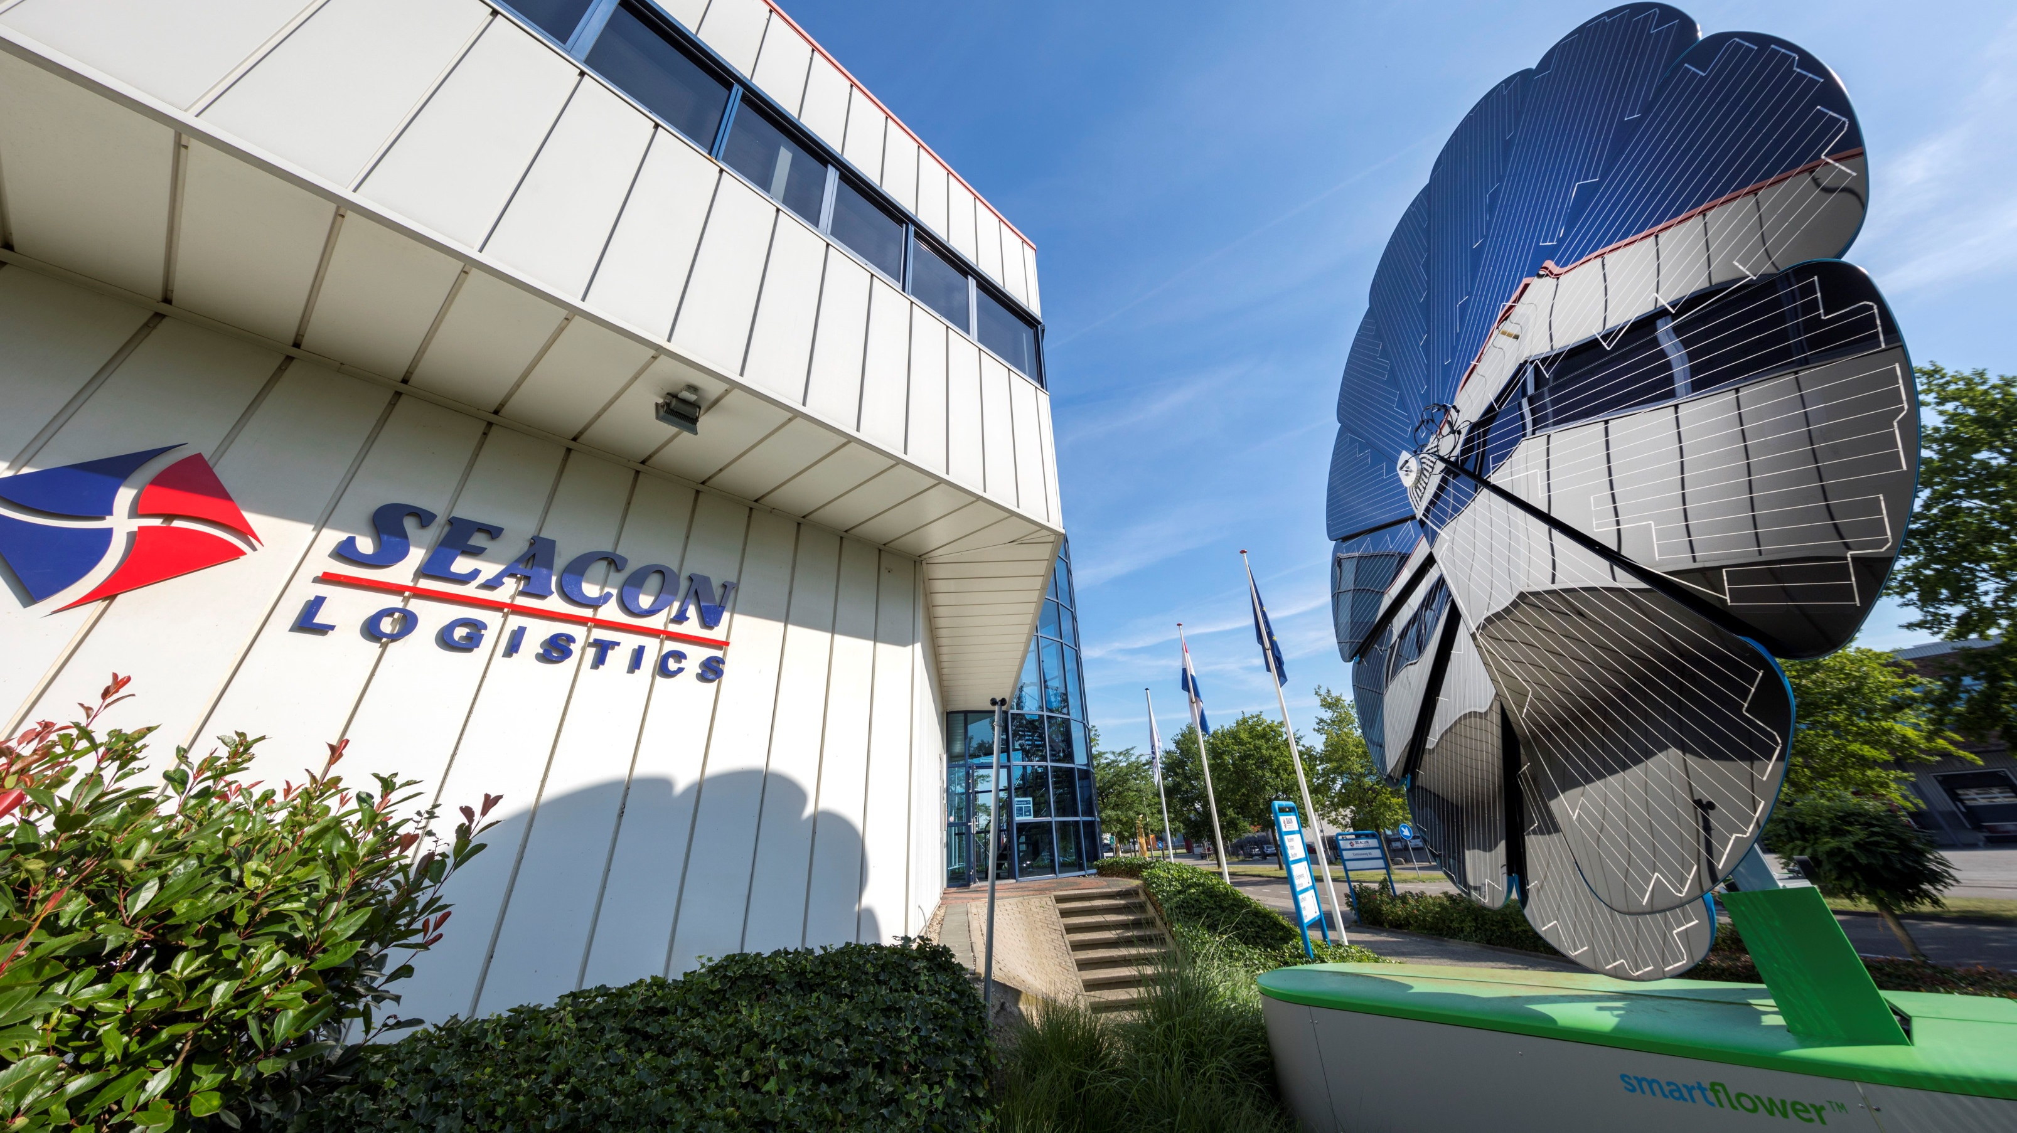
End of presentation
Thank you for your attention! Questions?

